Slide 1
Property Inspection Demo
Preparation and Walkthrough

Slide 2
Preparing The Data
The following slides illustrates the data that should be in the system when the demo is started. The Property Management My App provisions this data.
As you will see, some of the lists are read only and you will never have to delete data in them to reset the demo.
Lists that do not indicate they are read only should be trimmed of extra data to reset the demo.

Slide 3
Preparing Calendars
Log into OWA with Ron Gabel and delete all calendar invites for the day after the demo. For example, if you are doing the demo on the October 28 then delete all entries on the October 29.

Slide 4
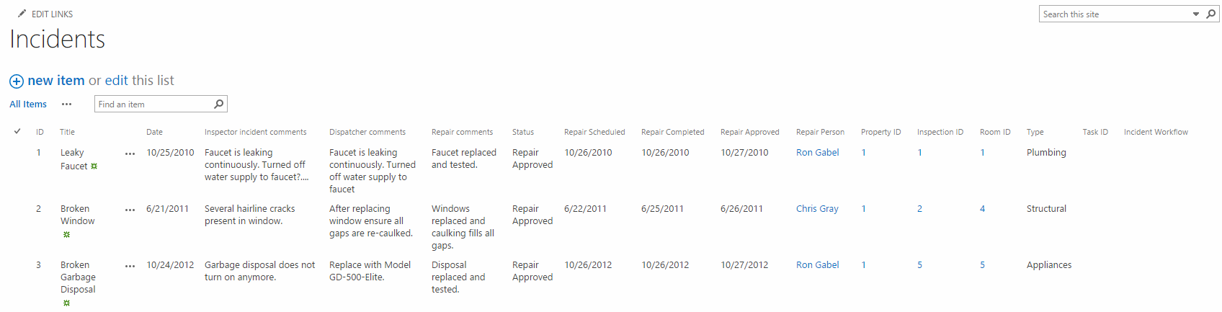
Incidents List The Property Management My App provisions the data in this list. Make sure your list matches the data pictured below.

Slide 5
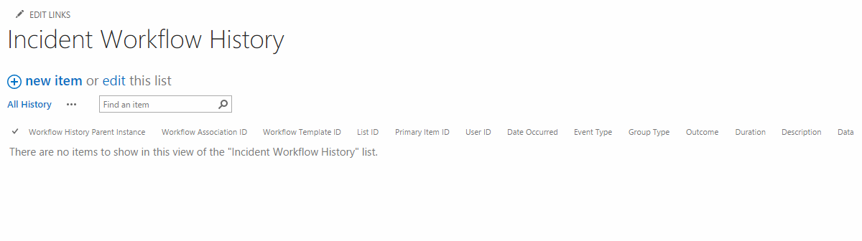
Incident Workflow History List This list is empty to start.

Slide 6
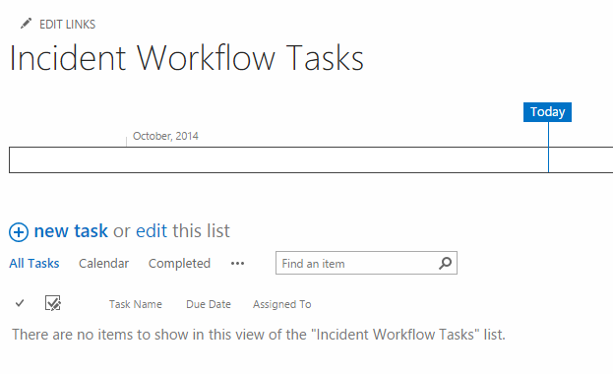
Incident Workflow Tasks List This list is empty to start.

Slide 7
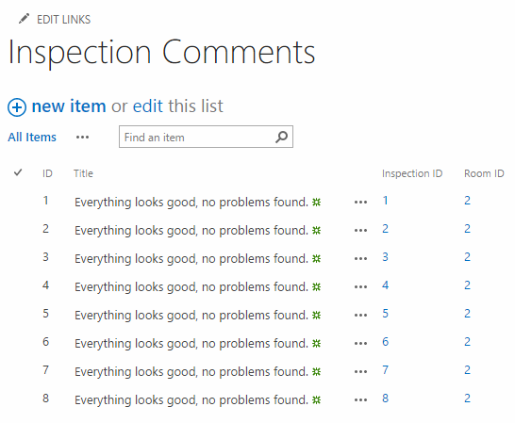
Inspection Comments The Property Management My App provisions the data in this list. Make sure your list matches the data pictured below.

Slide 8
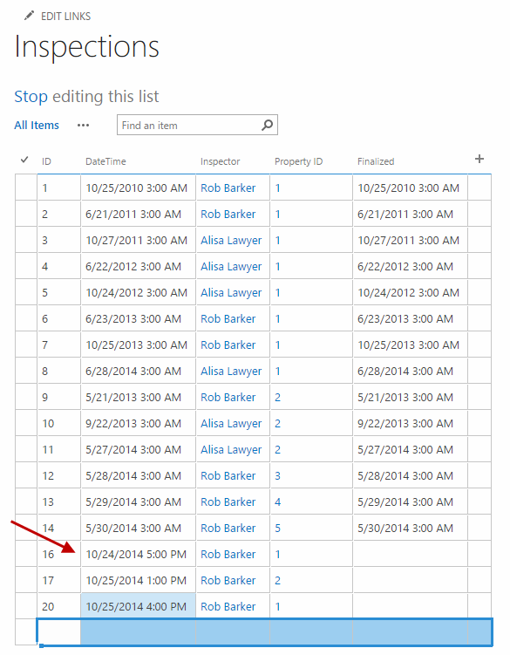
Inspections List The Property Management My App provisions the data in this list. Make sure your list matches the data pictured below.

Slide 9
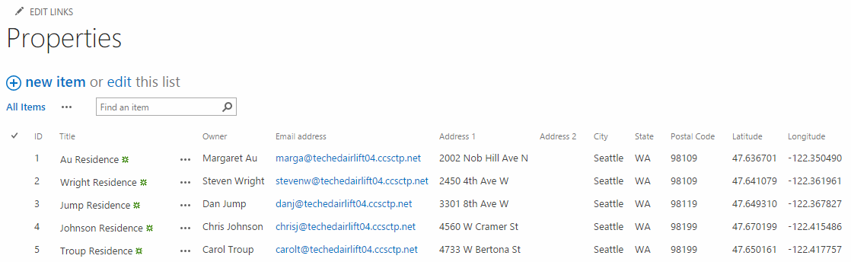
Properties List The Property Management My App provisions the data in this list. Make sure your list matches the data pictured below. This list is read only so you should never modify it or have to clean it out.

Slide 10
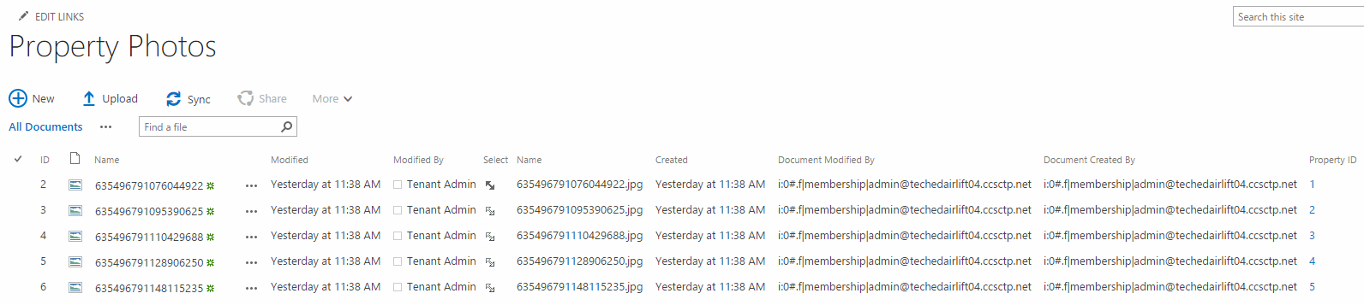
Property Photos The Property Management My App provisions the data in this list. Make sure your list matches the data pictured below. The Name values will differ in your tenancy.

Slide 11
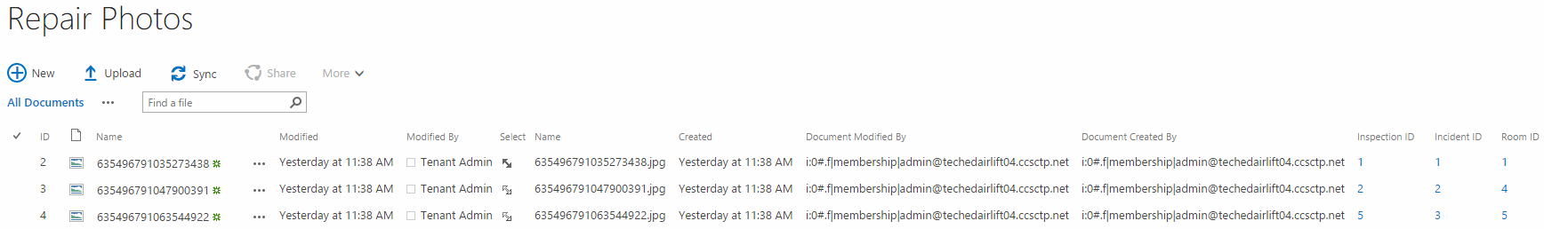
Repair Photos The Property Management My App provisions the data in this list. Make sure your list matches the data pictured below. The Name values will differ in your tenancy.

Slide 12
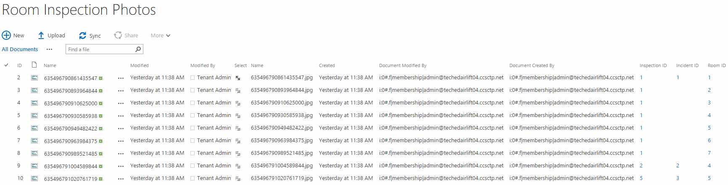
Room Inspection Photos The Property Management My App provisions the data in this list. Make sure your list matches the data pictured below. The Name values will differ in your tenancy.

Slide 13
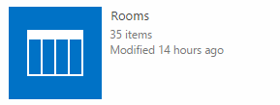
Rooms List. The Property Management My App provisions the data in this list. The Rooms list has 35 entries. This list is read only so you should never modify it or have to clean it out.

Slide 14
Walkthrough
These following slides describe how to execute the demo, the lists items that are modified during each step, and the emails which are sent.

Slide 15
Inspection Walkthrough

Slide 16
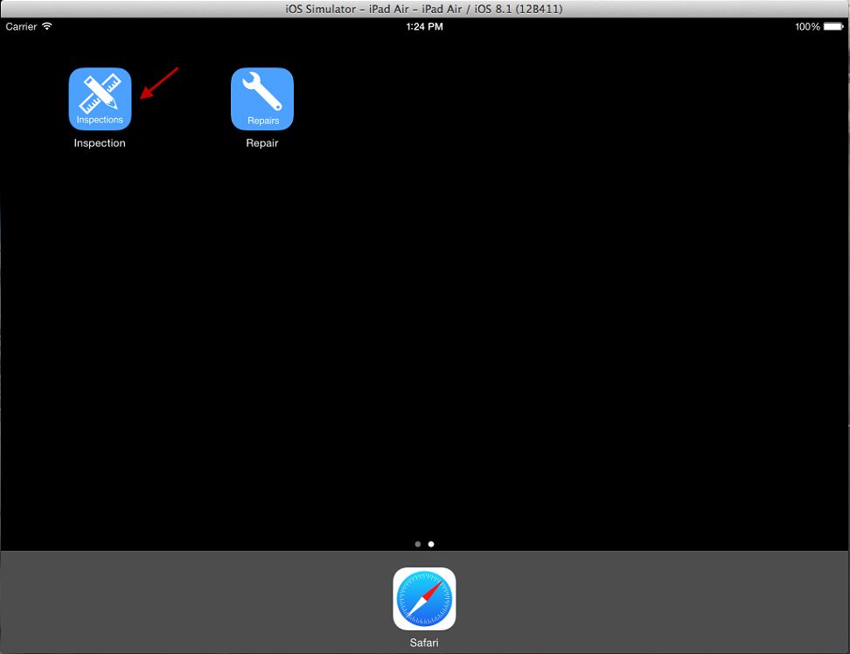
Open Inspection App On iPad

Slide 17
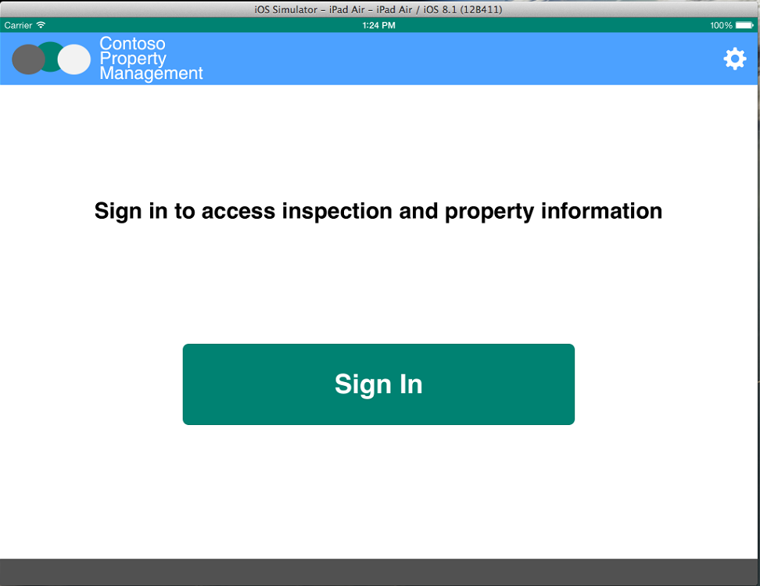
Click Sign In

Slide 18
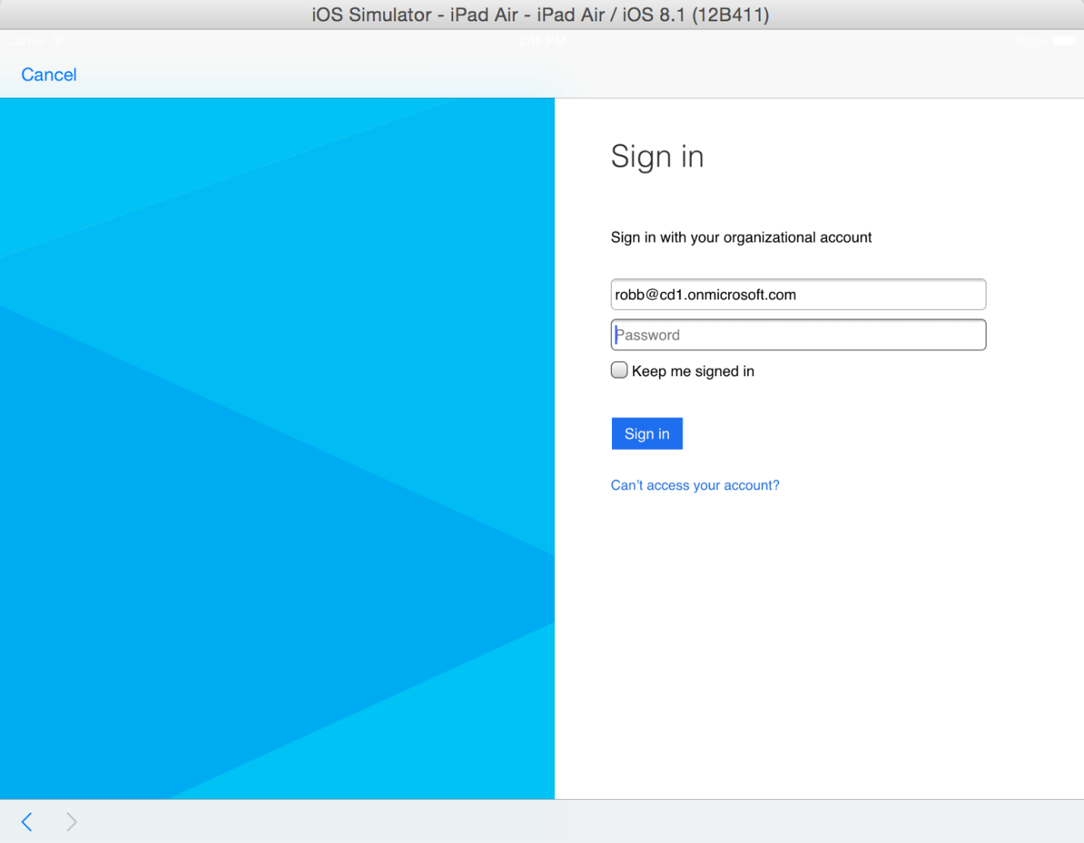
Enter Inspector Credentials Username: robb@<tenanacy>.onmicrosoft.com Password: TempP@ssw0rd! Do not check Keep Me Signed In Click Sign In If you have not already signed in with this user you will be prompted to reset the user’s password.

Slide 19
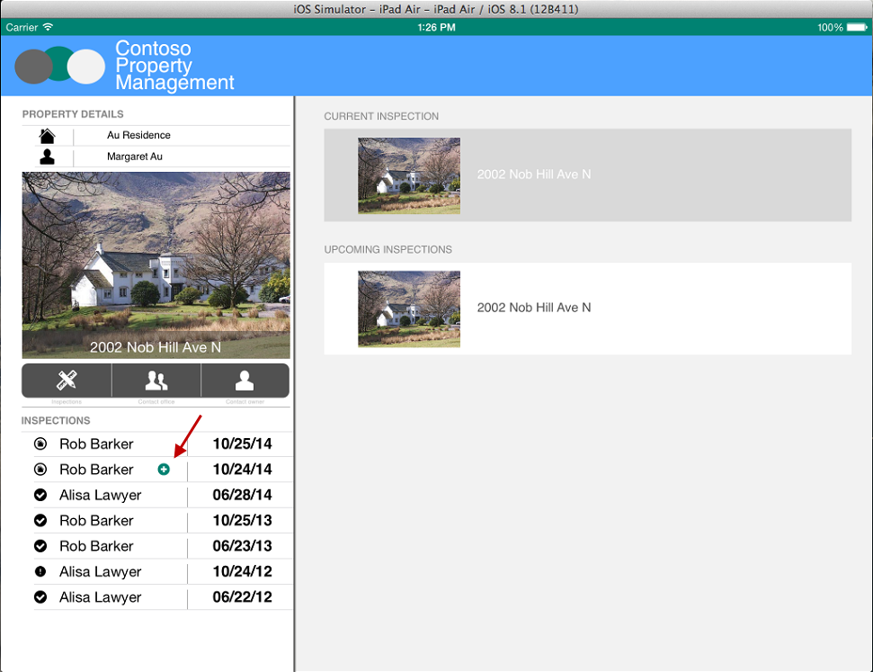
Click Inspection With Plus Icon

Slide 20
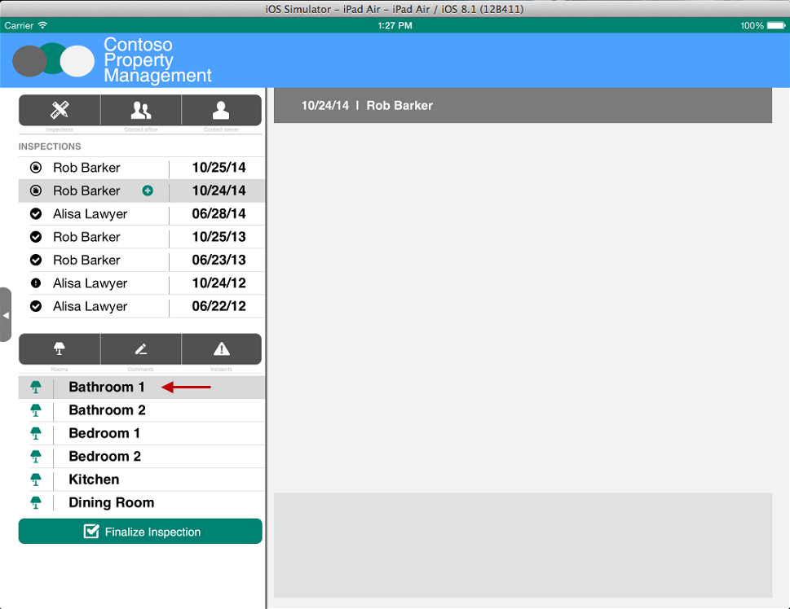
Select Bathroom 1

Slide 21
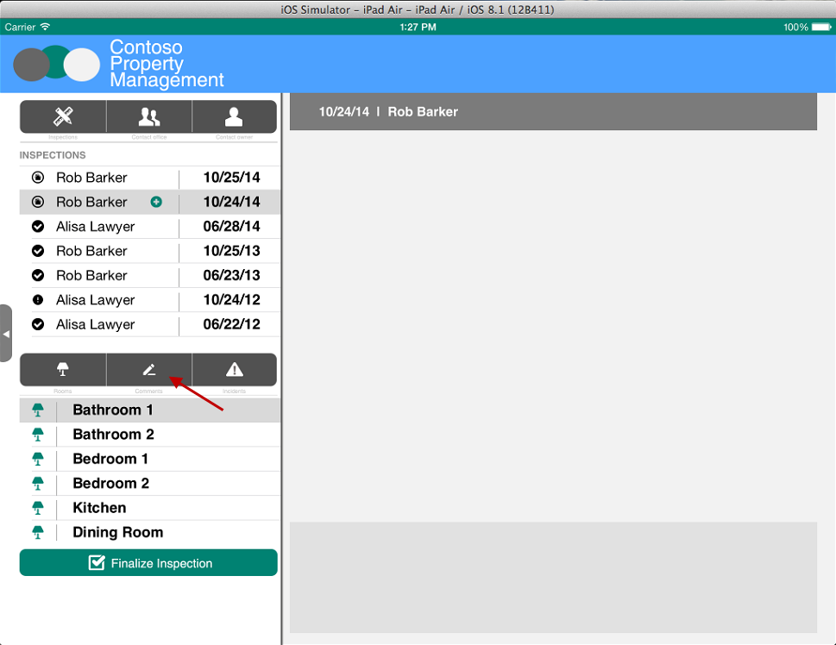
Click Comments

Slide 22
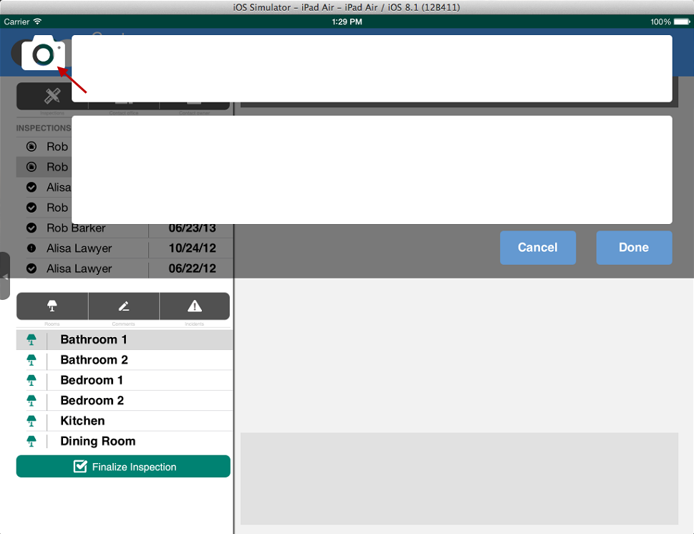
Click Camera

Slide 23
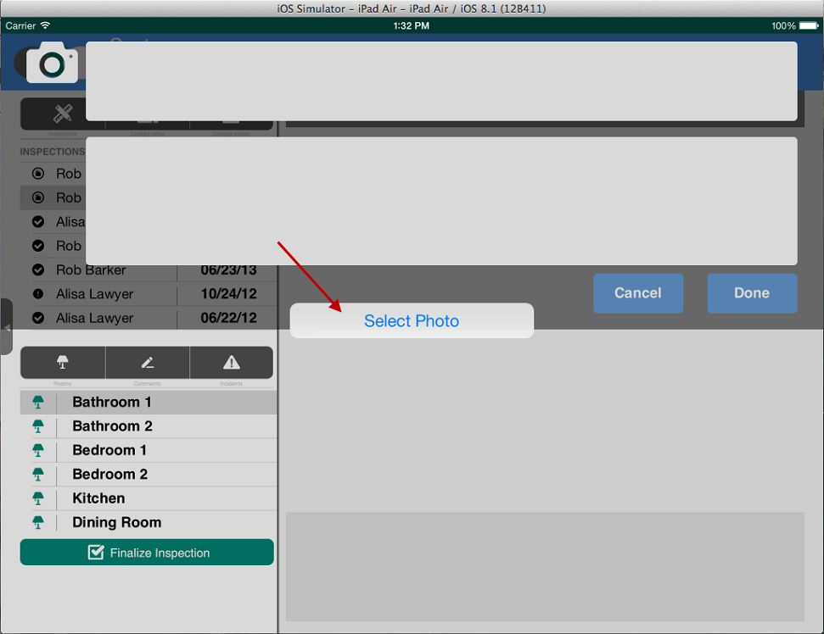
Select Photo On Simulator Or Take Picture On iPad

Slide 24
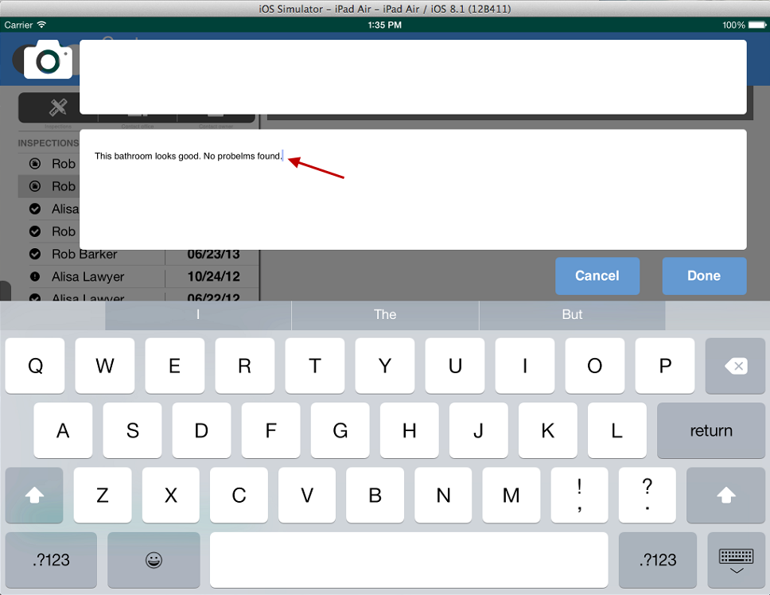
Enter Comments

Slide 25
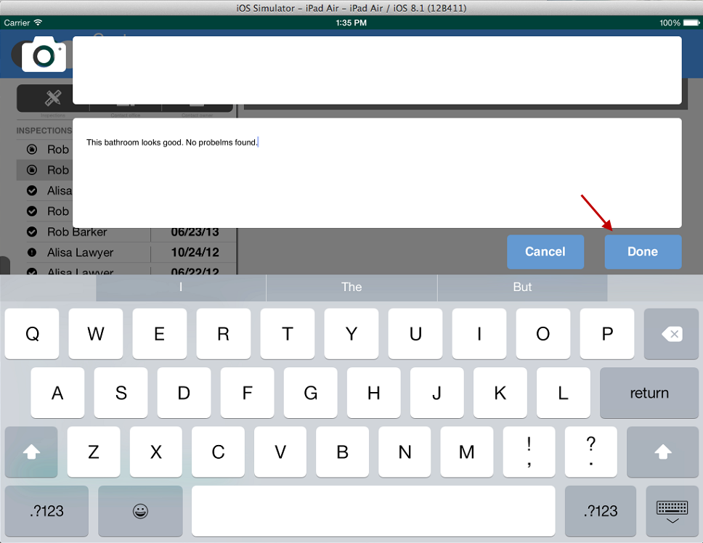
Click Done

Slide 26
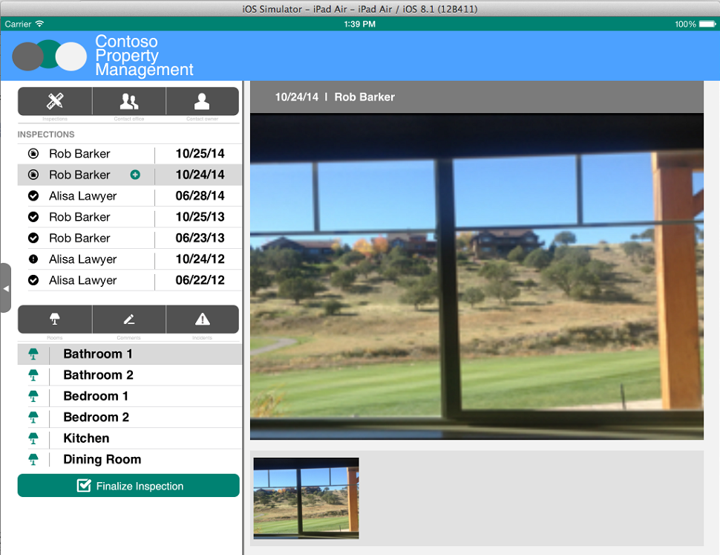
Picture is Uploaded

Slide 27
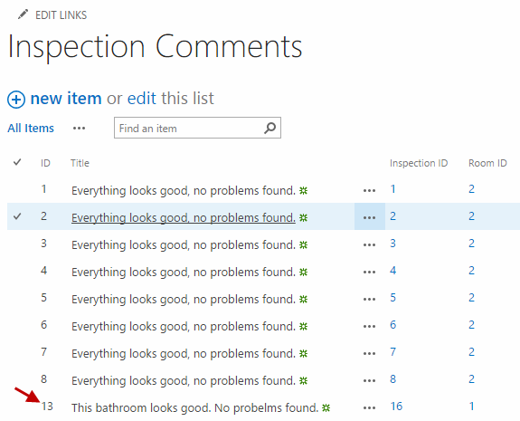
Inspection Comment is created in Inspection Comments List

Slide 28
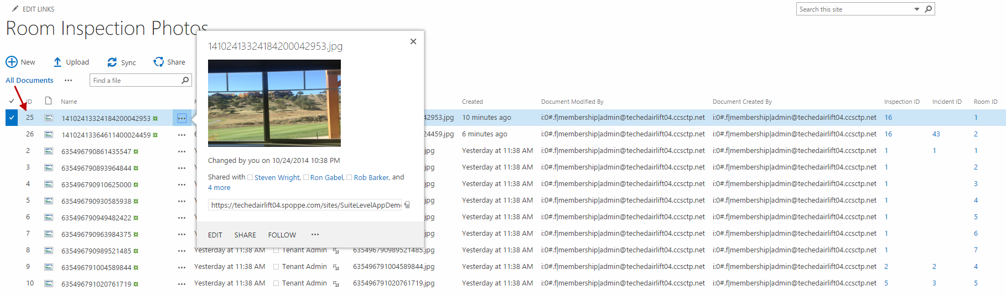
Photo is added to Room Inspection Photos Library

Slide 29
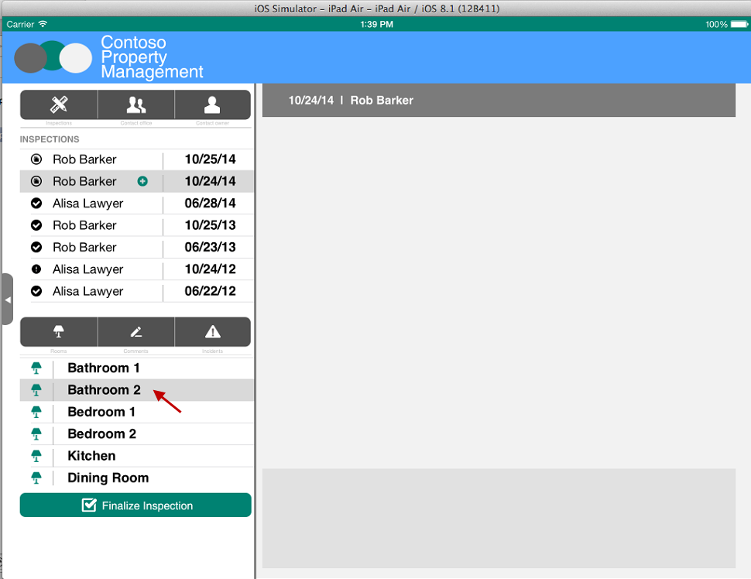
Select Bathroom 2

Slide 30

Click Incidents

Slide 31
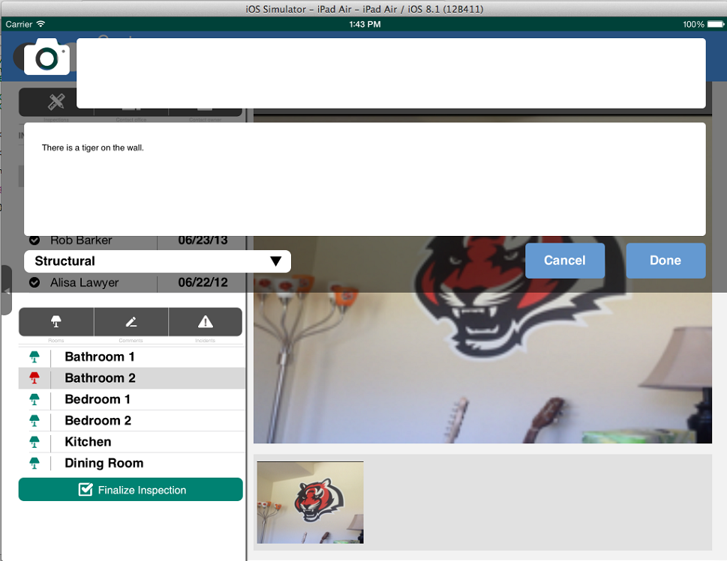
Just like you did in the Inspection Comments popup, take a picture and enter comments. Then, select an Incident Type and click Done.

Slide 32
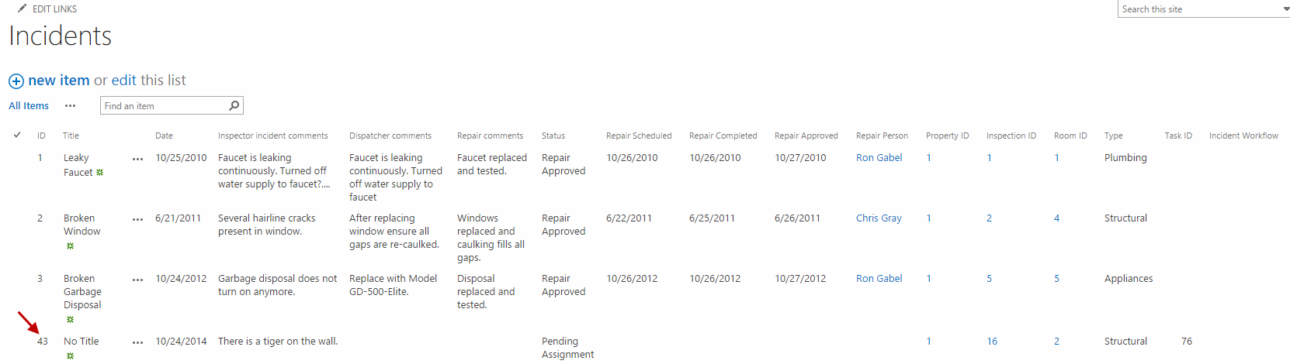
Incident is created in Incidents List

Slide 33
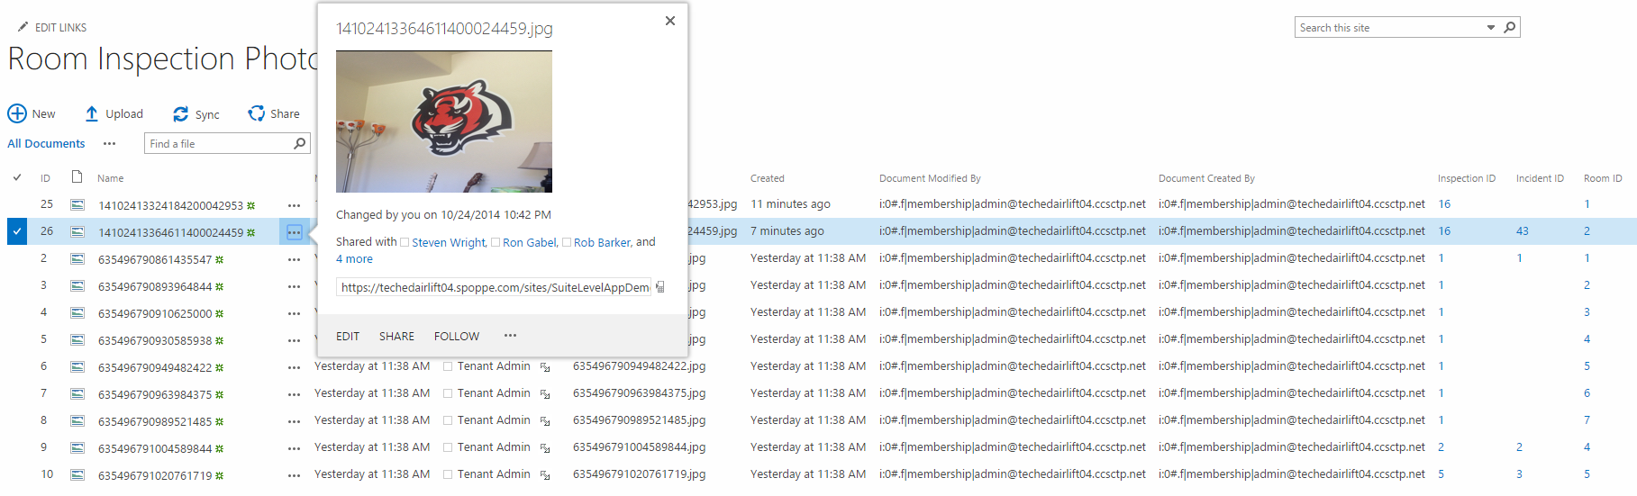
Photo is added to Room Inspection Photos Library

Slide 34
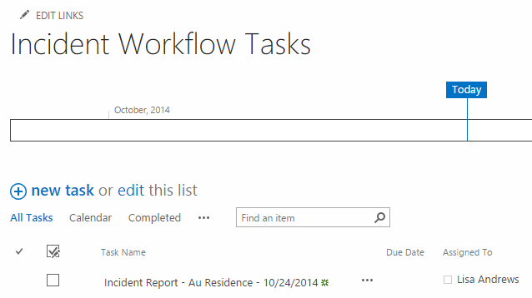
Workflow Task is created for Dispatcher

Slide 35
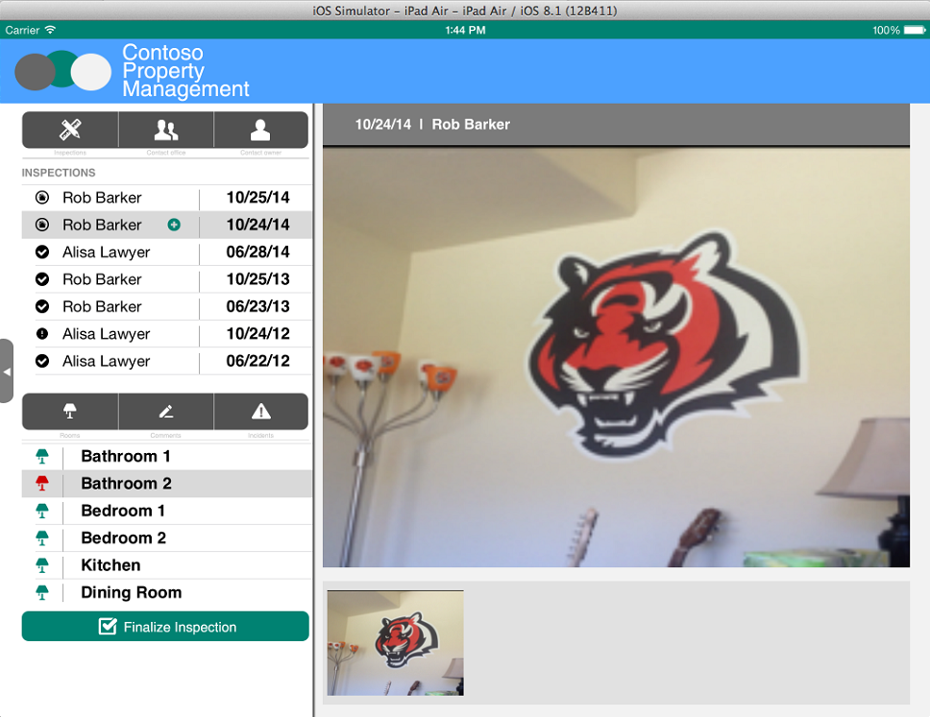
Click Finalize Inspection

Slide 36
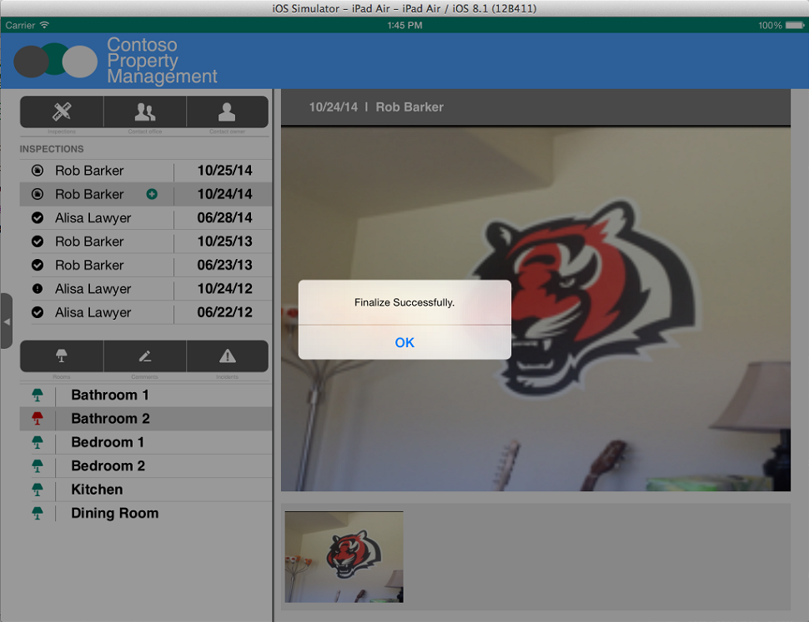
Get Confirmation

Slide 37
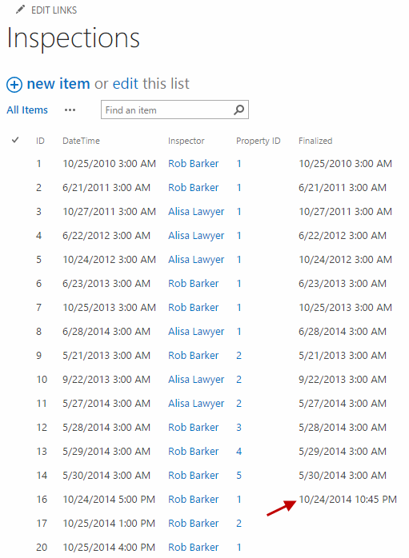
Inspection is updated with Finalized Date

Slide 38
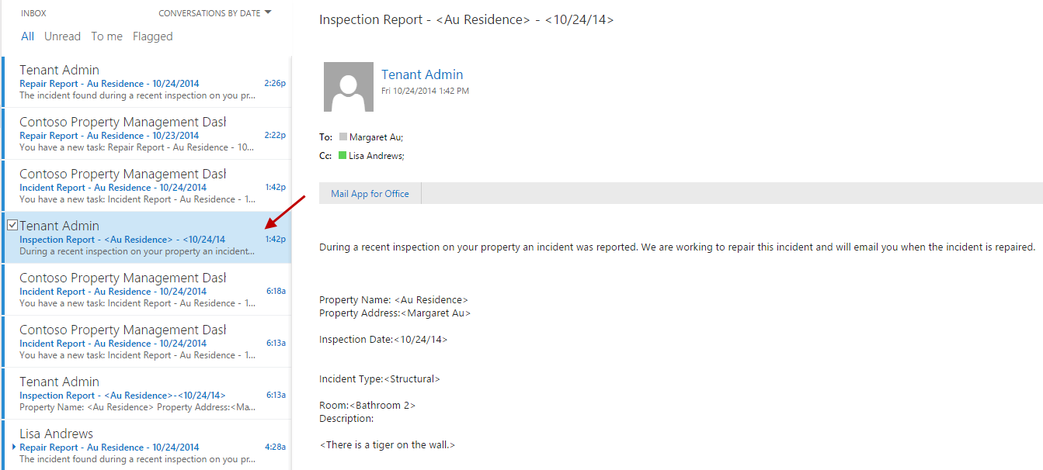
Inspection report email is sent to property owner and dispatcher Log in with Dispatcher account to see the email

Slide 39
Dispatcher Scheduling Walkthrough

Slide 40
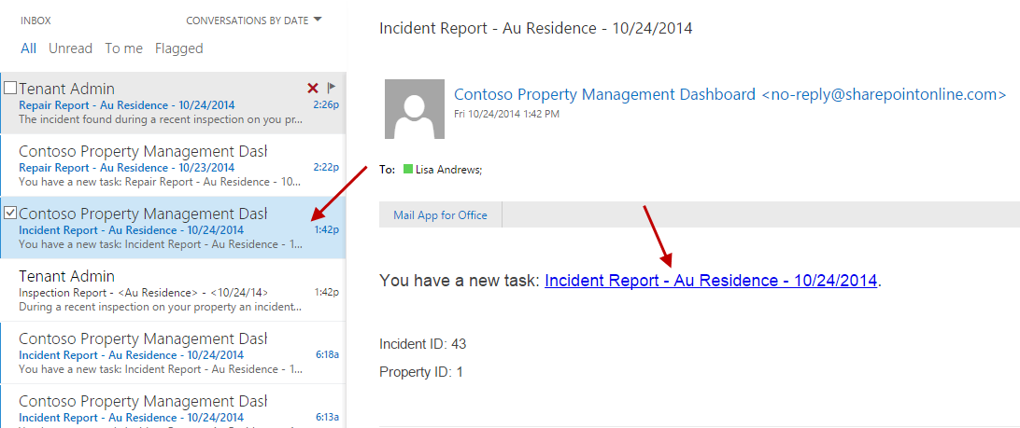
Email with Task to Assign Repair Person is sent to dispatcher Log in with Dispatcher account to see the email

Slide 41
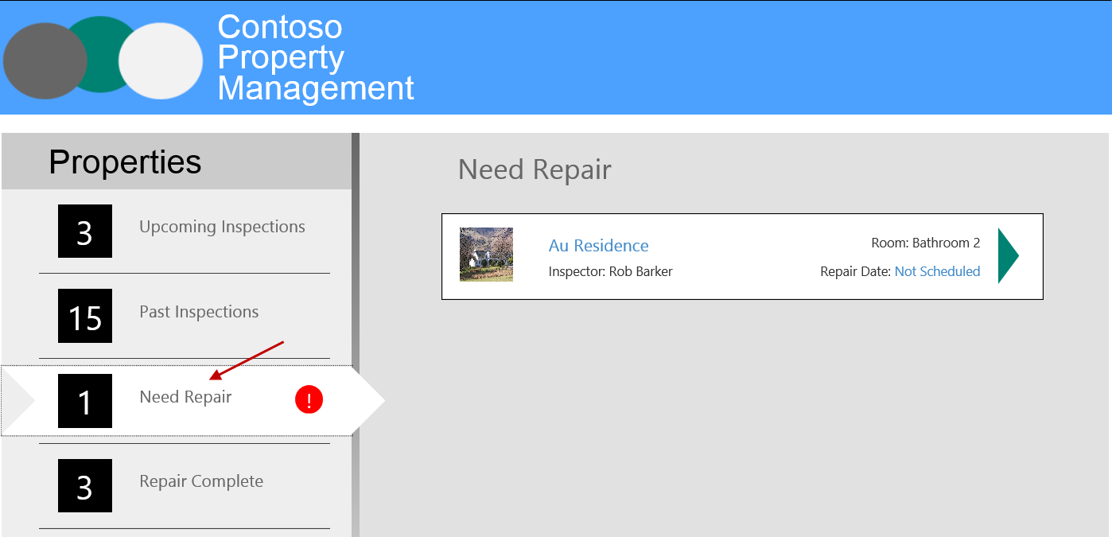
Open Property Management My App Dashboard, click Need Repair

Slide 42
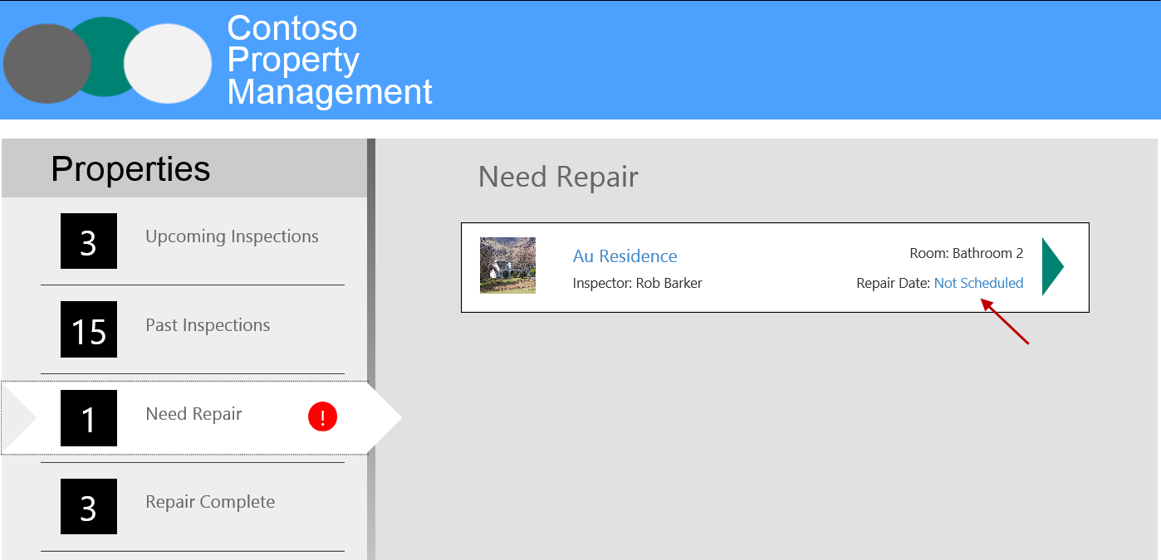
Click Not Scheduled

Slide 43
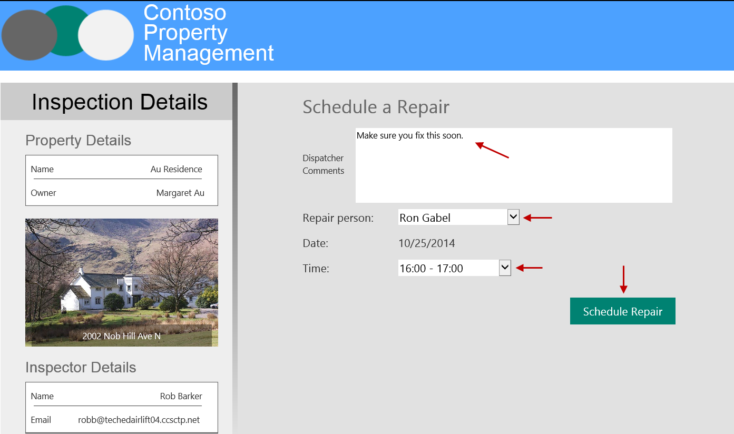
Enter comments, select Ron Gabel, select Time, click Schedule Repair

Slide 44
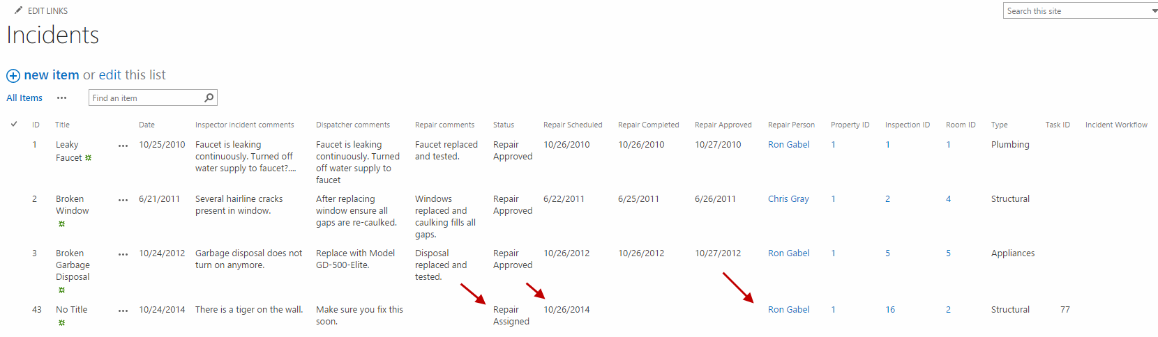
Incident is updated to reflect Status, Repair Scheduled Date, and Repair Person assigned

Slide 45
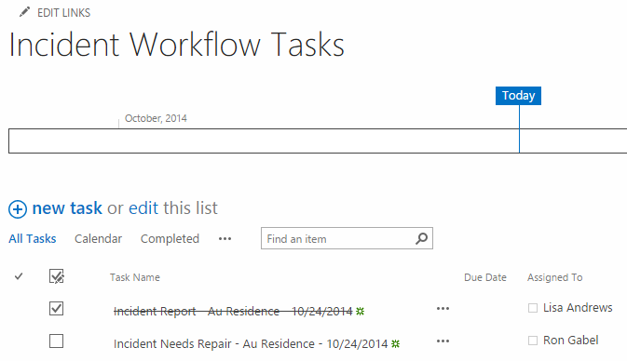
Workflow Task for Dispatcher is completed Workflow Task for Repair Person is created

Slide 46
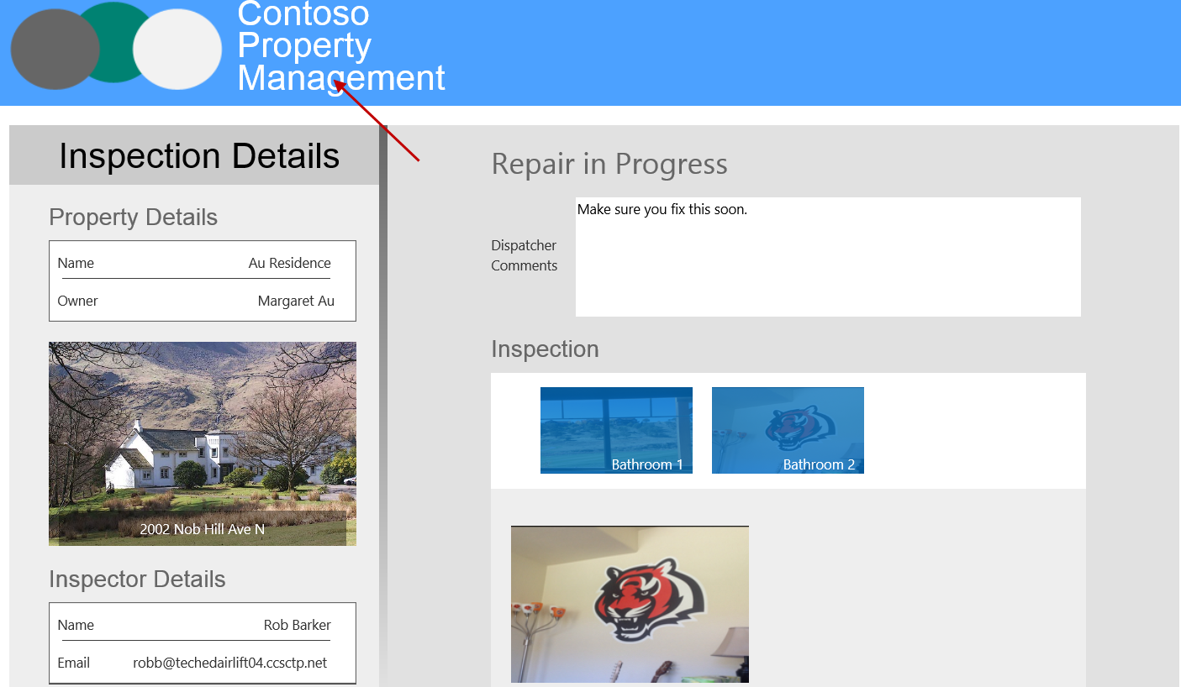
Click the header

Slide 47
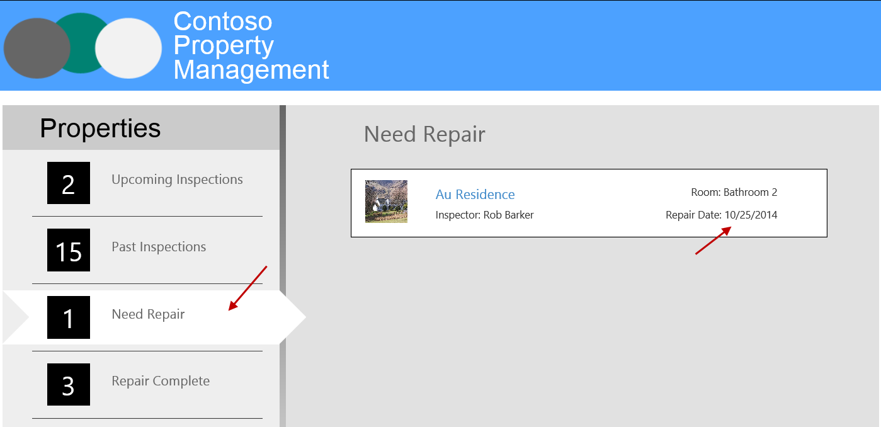
Click Need Repair and mention the repair is scheduled

Slide 48
Repair Walkthrough

Slide 49
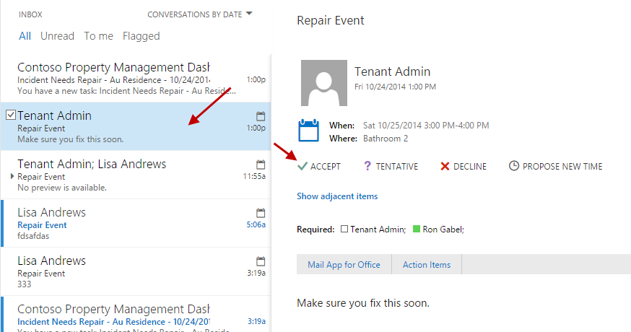
View Calendar Invite Sent To Ron Gabel And Accept Log in with Repair Person account to see the email

Slide 50
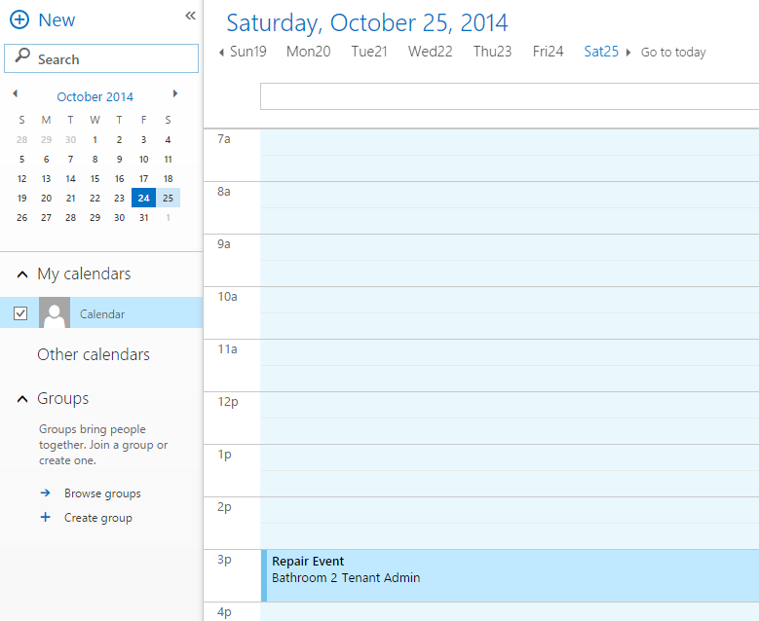
View Calendar Event

Slide 51
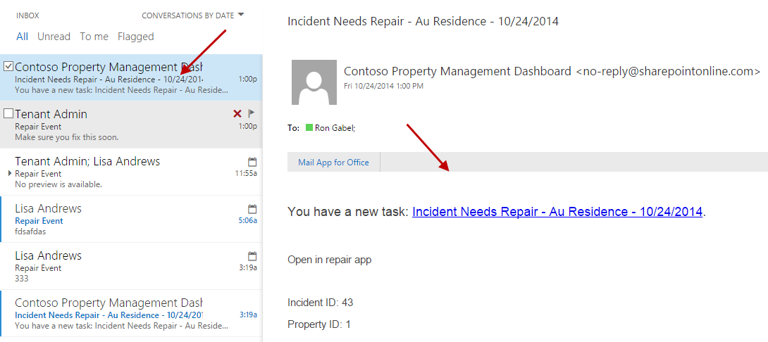
View Repair Task Email sent to Ron Gabel Log in with Repair Person account to see the email

Slide 52
Click Open in Repair App

Slide 53
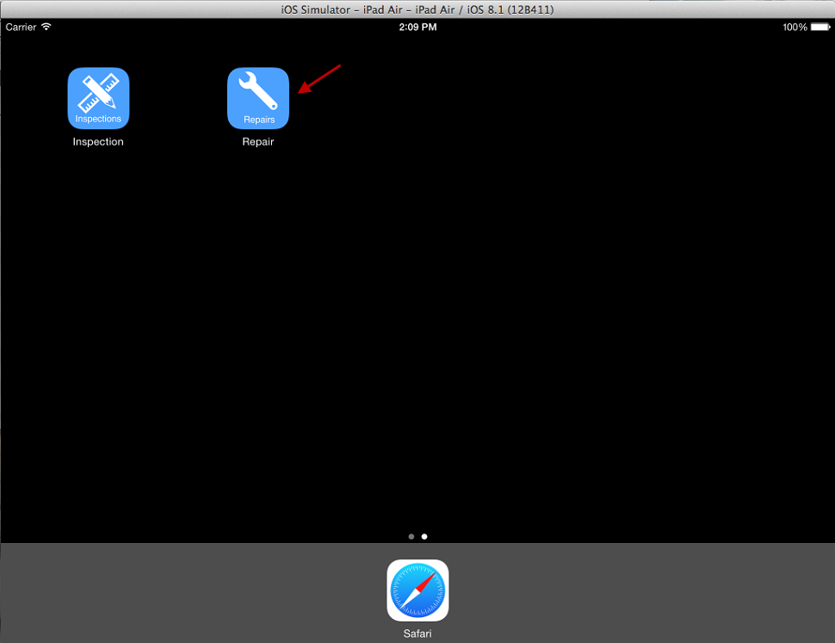
Open Repair App

Slide 54
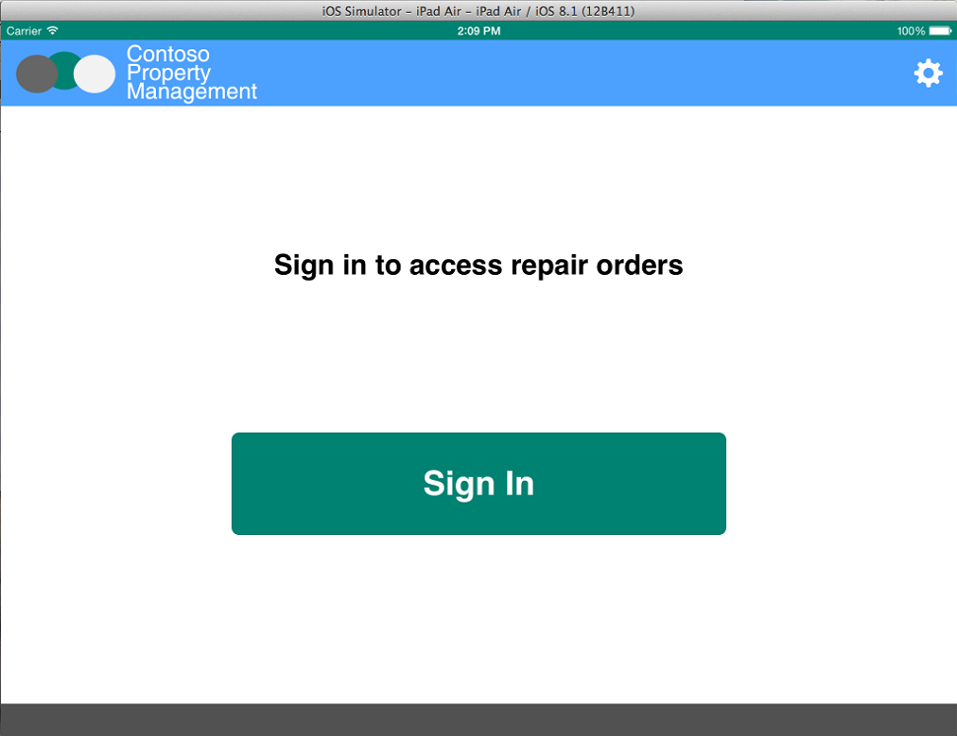
Click Sign In

Slide 55
Enter Inspector Credentials Username: rong@<tennacy>.onmicrosoft.com Password: TempP@ssw0rd! Do not check Keep Me Signed In Click Sign In If you have not already signed in with this user you will be prompted to reset the user’s password.

Slide 56
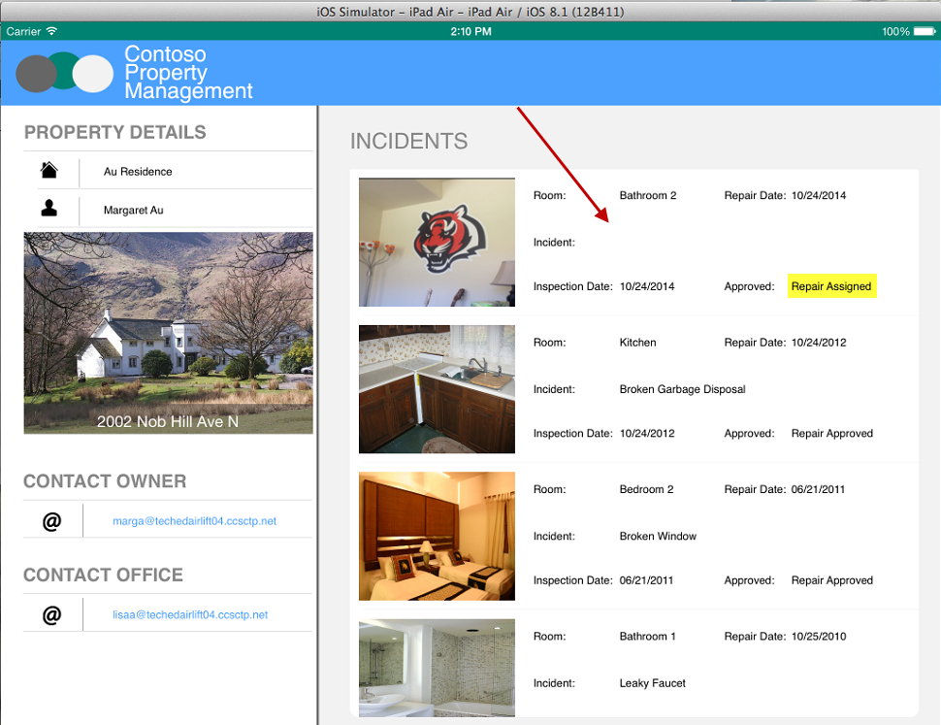
Click the Repair Incident assigned by the Dispatcher

Slide 57
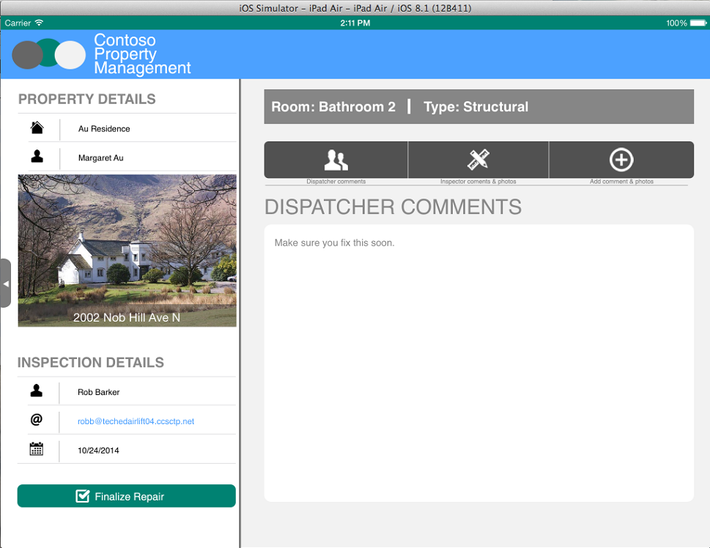
Look at Dispatcher Comments

Slide 58

Click Inspector Comments and Photos

Slide 59
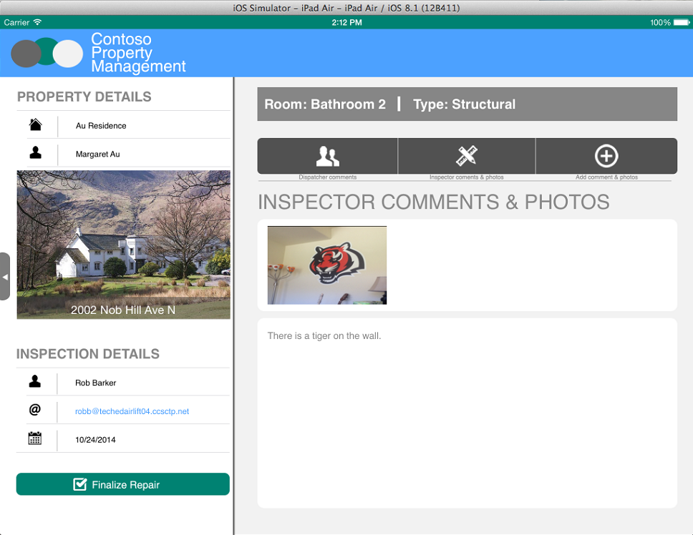
Look at Inspector Comments

Slide 60
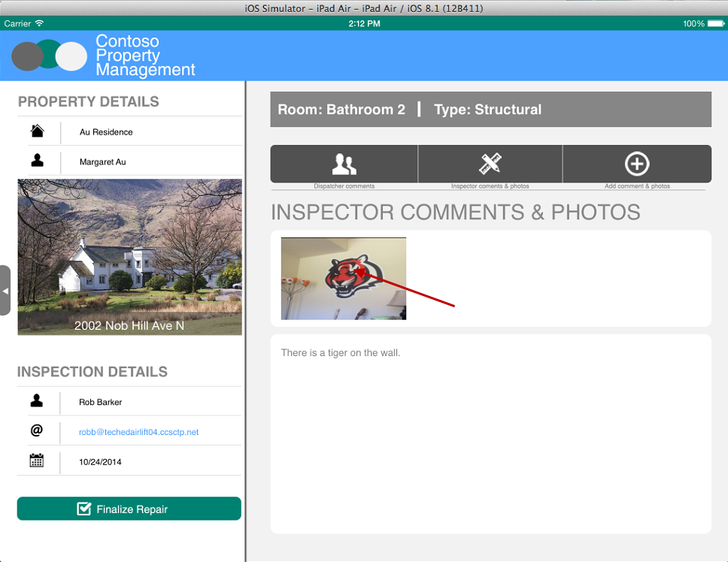
Click Photo

Slide 61
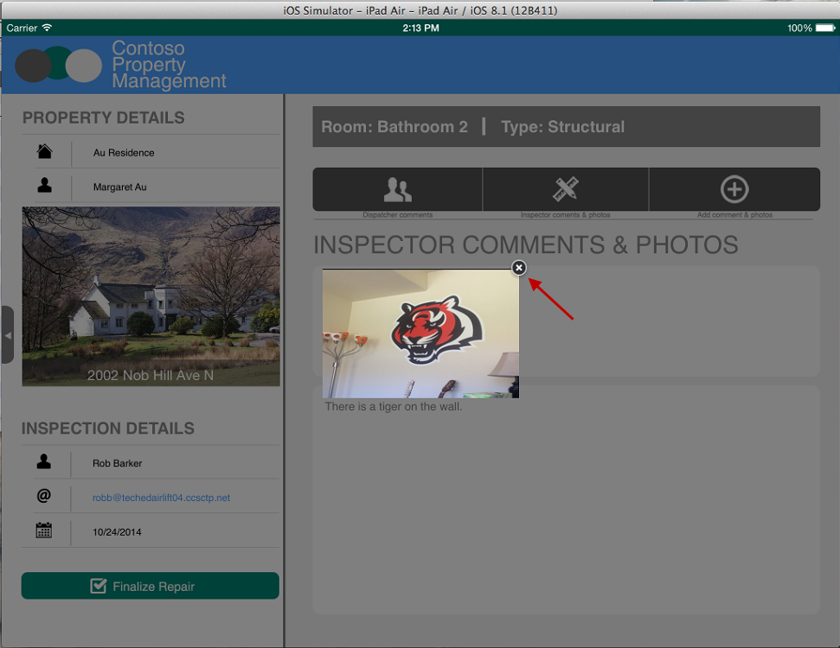
View Photo Full Size, Click X to Close

Slide 62

Click Add Comment And Photos

Slide 63

Click Finalize Repair

Slide 64

Incident list updated with Repair comments, Status, and Repair Completed date

Slide 65

Photo is added to Repair Photos Library

Slide 66

Workflow Task for Repair Person is completed Workflow Task for Dispatcher is created

Slide 67
Approve Repair Walkthrough

Slide 68

Email is sent to Dispatcher to approve repair Log in with Dispatcher account to see the email

Slide 69

Refresh Property Management My App and click Repair Complete

Slide 70

Click Not Approved

Slide 71

Browse all data and images and click Approve Repair

Slide 72

Refresh Property Management My App and click Repair Complete to see completed status

Slide 73

Workflow Task for Dispatcher is completed

Slide 74

Incident is updated with Repair Approved Status and Date

Slide 75

Workflow History is updated to close workflow

Slide 76

Repair Report Email is sent to Dispatcher and Property Owner Log in with Dispatcher account to see the email

